Slide 1

3D Mesh Compression: Survey, Comparisons, and Emerging Trend
Lin Zhang (lzhang50@usc.edu)

Slide 2
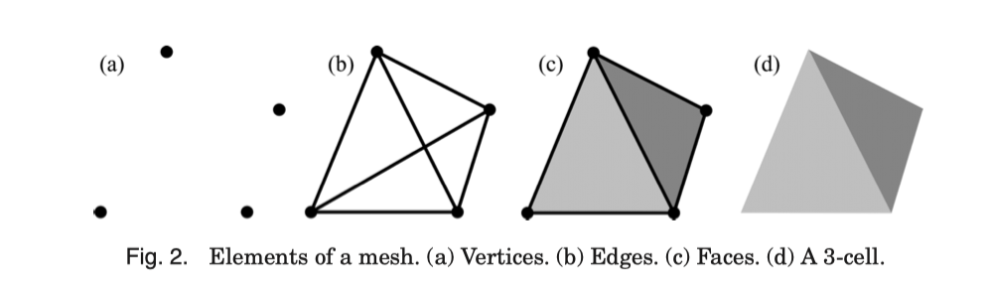
Point cloud -> Meshes (base element)
Mesh -> Vertices
In order to form a point cloud, we need to store:
The connectivity information
The geometry information
The optional attribute information(colors, scalar…)
The mesh connectivity describes the relations among mesh elements. (e.g., adjacent vertices and edges of faces, etc).
The mesh geometry specifies the position and other geometric info of each vertex.

Slide 3
Topic:
Goals: Reduces data size, which is useful for data storing and transmitting.
Meshes Classification:
Static
Dynamic
Meshes type:
Surface meshes
Volume meshes
c) Other concept:
Mesh sequence
d) Compression Classification:
Single-rate algorithms
Progressive algorithms
Random accessible algorithms
Progressive and Random Accessible Compression

Slide 4
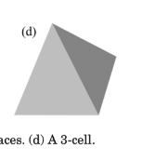

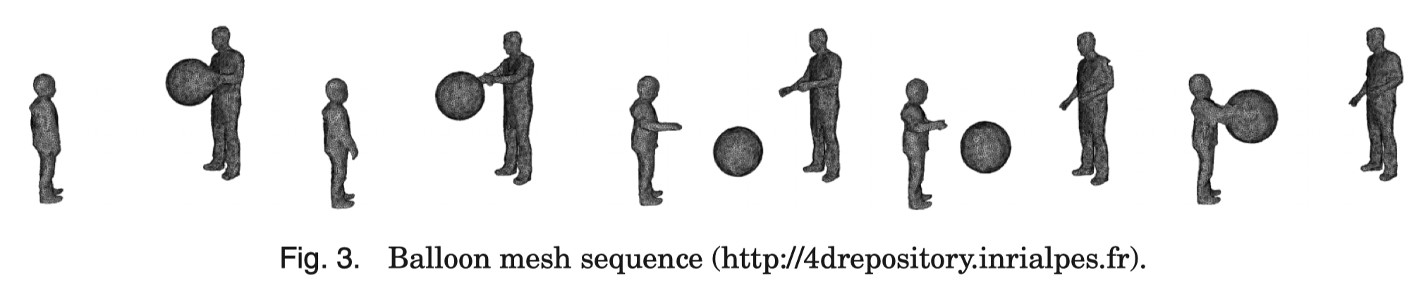
b) Meshes type
Surface meshes ( two dimensions ):
A surface mesh consists of a set of faces, often triangles, that, taken together, form a surface covering of the object. The advantage of a surface mesh is that it is fast to generate and works very well for visualization.
Volume meshes ( three dimensions ):
Volume meshes deﬁne a volume ﬁlled by a set of 3-cells.
c) Mesh sequence
A mesh sequence is a series of meshes ordered in time.

Slide 5
Mesh sequence
Two different types of sequences (dynamic meshes)
1)connectivity is constant over the whole sequence
Temporally coherent mesh sequence (TCMS)
1) The number of vertices remains constant through time,
2) One-to-one correspondence between faces of any two meshes.
3) Topological changes are not possible in a TCMS
2)~ not constant:
Temporally incoherent mesh sequence (TIMS)
1) Not necessarily to link a vertex between two mashes
2) variable number of vertices and variable connectivity

Slide 6
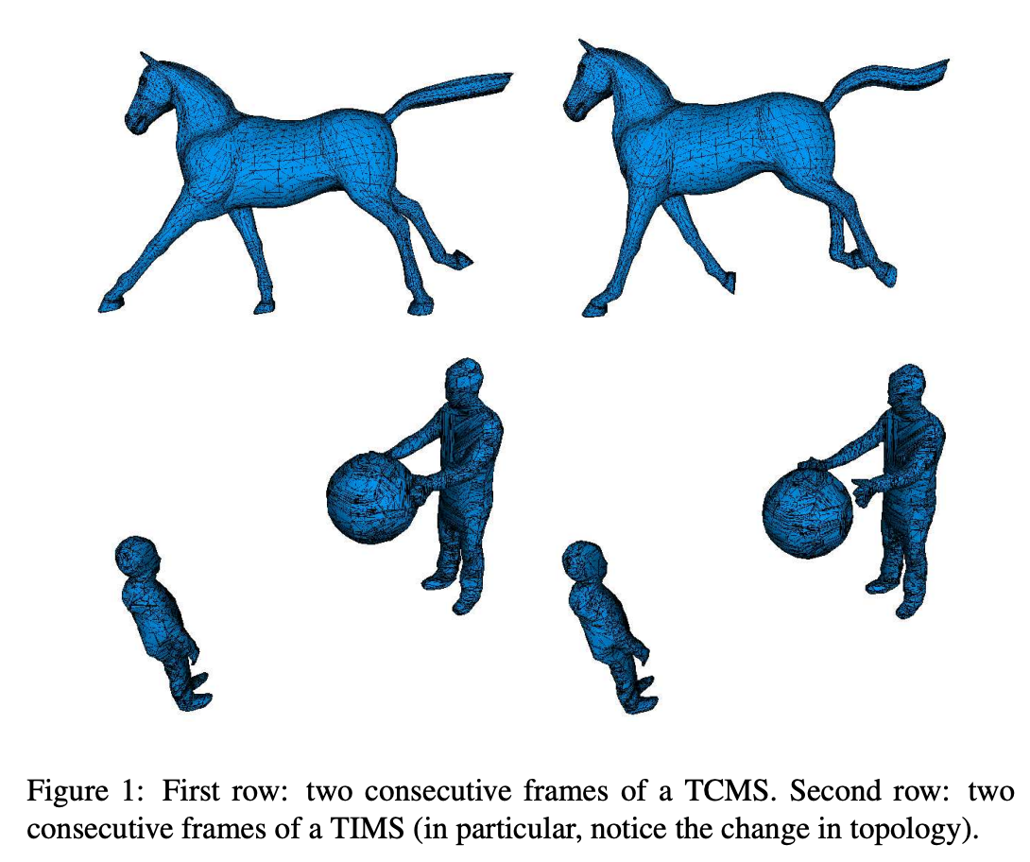
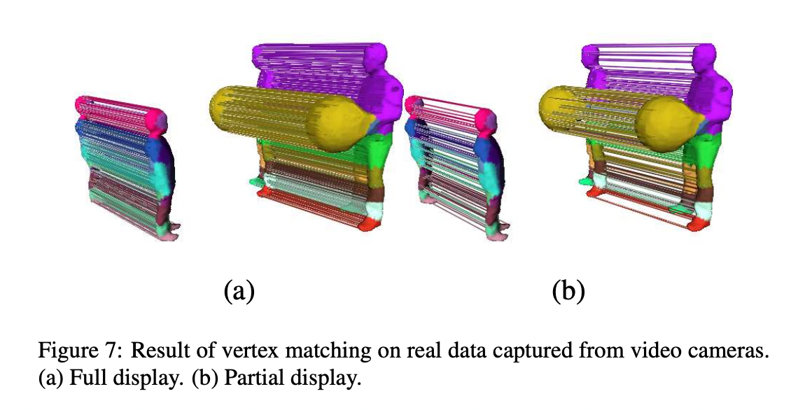
Mesh sequence
One Matching results of TIMS
30 seconds for two meshes with approximately 7000 vertices each

Slide 7
d) Compression Classification
1. Single-rate
Build a compact representation of an input mesh.
Decompression is either identical or slightly different.
2. Progressive algorithms:
User does not have to wait for all of the data to be downloaded to visualize the model
(pro: remote visualization)
3. Random accessible algorithms:
Only decompress part of the input mesh to save resources.
(con: cannot access non selected parts)
4. Progressive and Random Accessible Compression

Slide 8
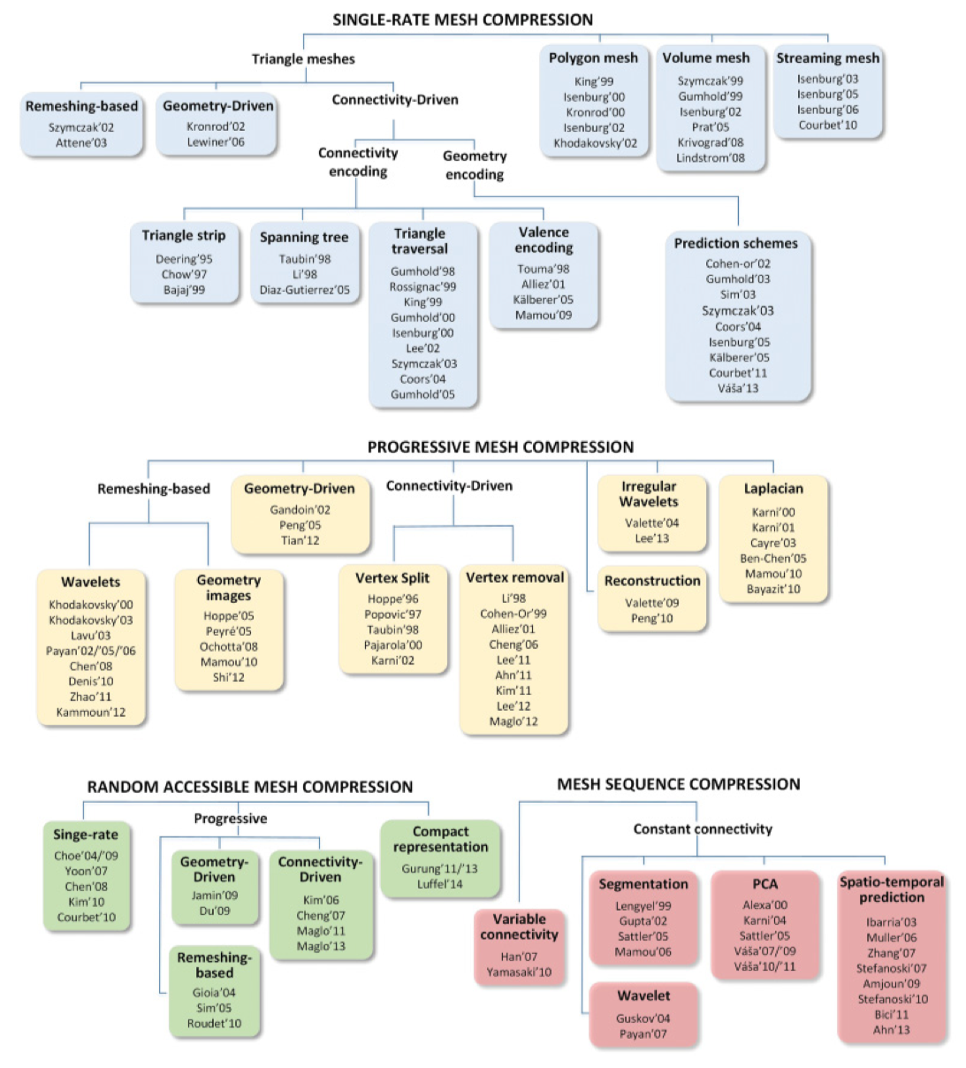
Overall

Slide 9
1. Single-rate mesh compression
1.1 Connectivity Compression
1.2 Geometry Compression

Slide 10
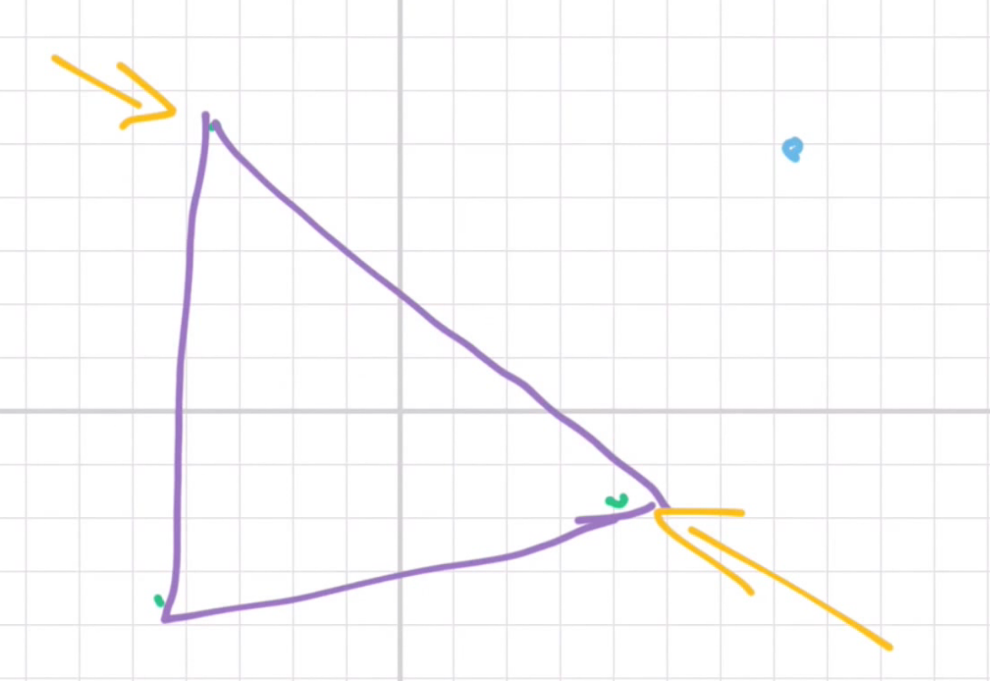
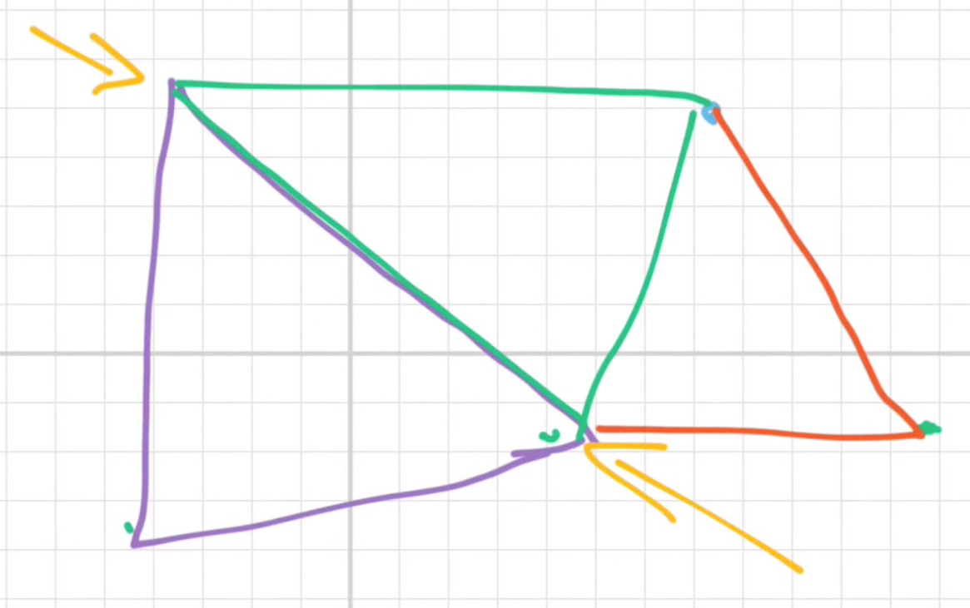
1.1 Connectivity Compression
1.1.1 Triangle Strip Encoding (mesh representations)
A triangle fan is a set of triangles sharing a common center vertex.
A triangle strip is a sequence of vertices where each added vertex deﬁnes a new triangle with the two previous vertices.

Slide 11


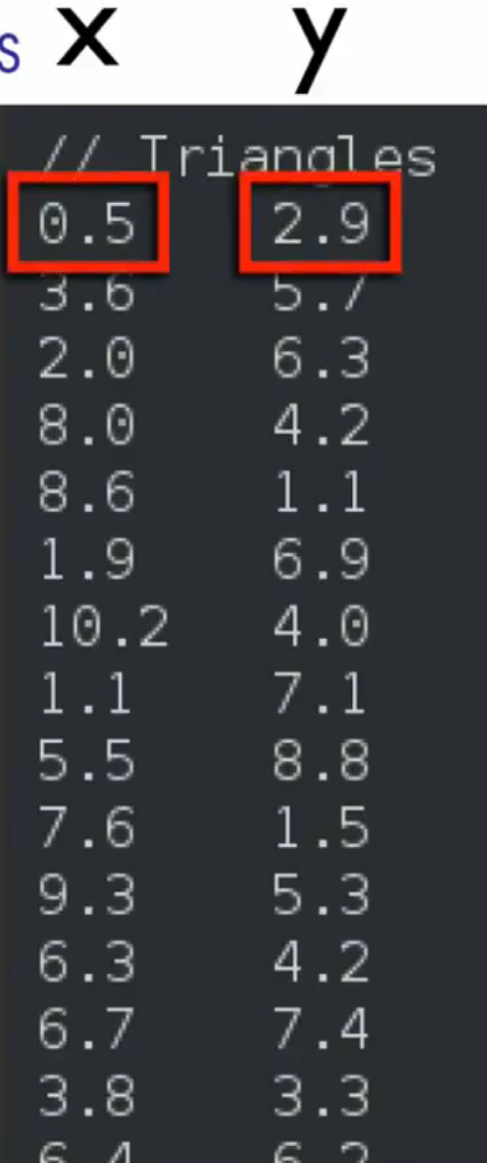
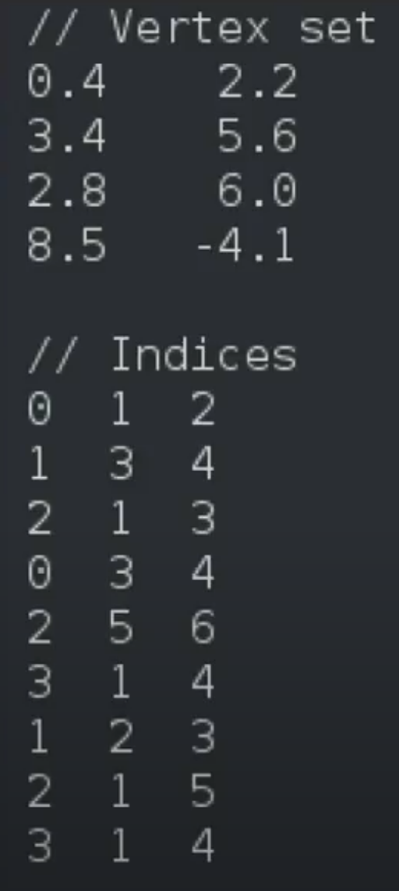
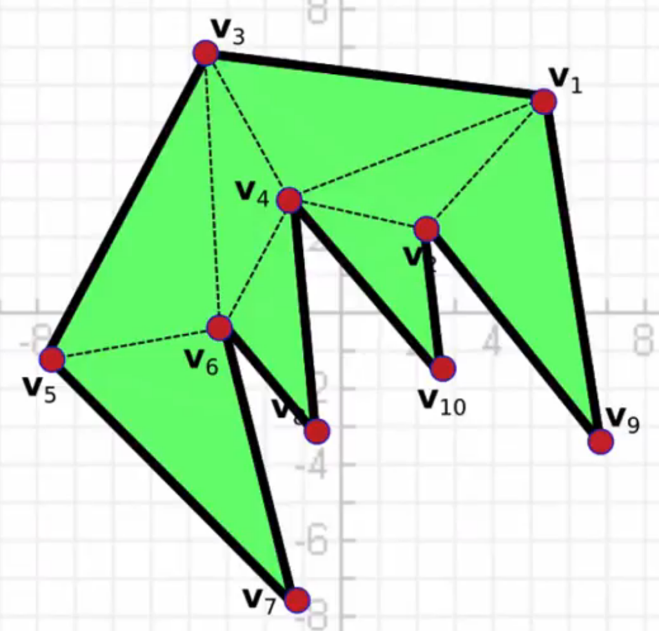
Connectivity
1.1.1 one example:
Geometry
Pick vertices and draw triangles - v4 needs to present 5 times in the table
optimize

Slide 12
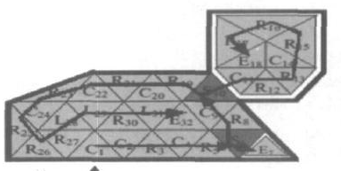
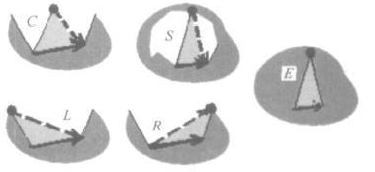
1.1 Connectivity Compression
1.1.2 Triangle Taversal Encoding (triangle spanning tree)
Edgebreaker
C: Third vertex is not on the boundary
L,R: Third vertex is on the boundary,
Two edges on the boundary.
S: Divides the figure into two parts
E: All three edges of the triangle are on the boundary
Encoding: CCRCRSERCSCRRCRRRERC RCRCRRRLLRL

Slide 13
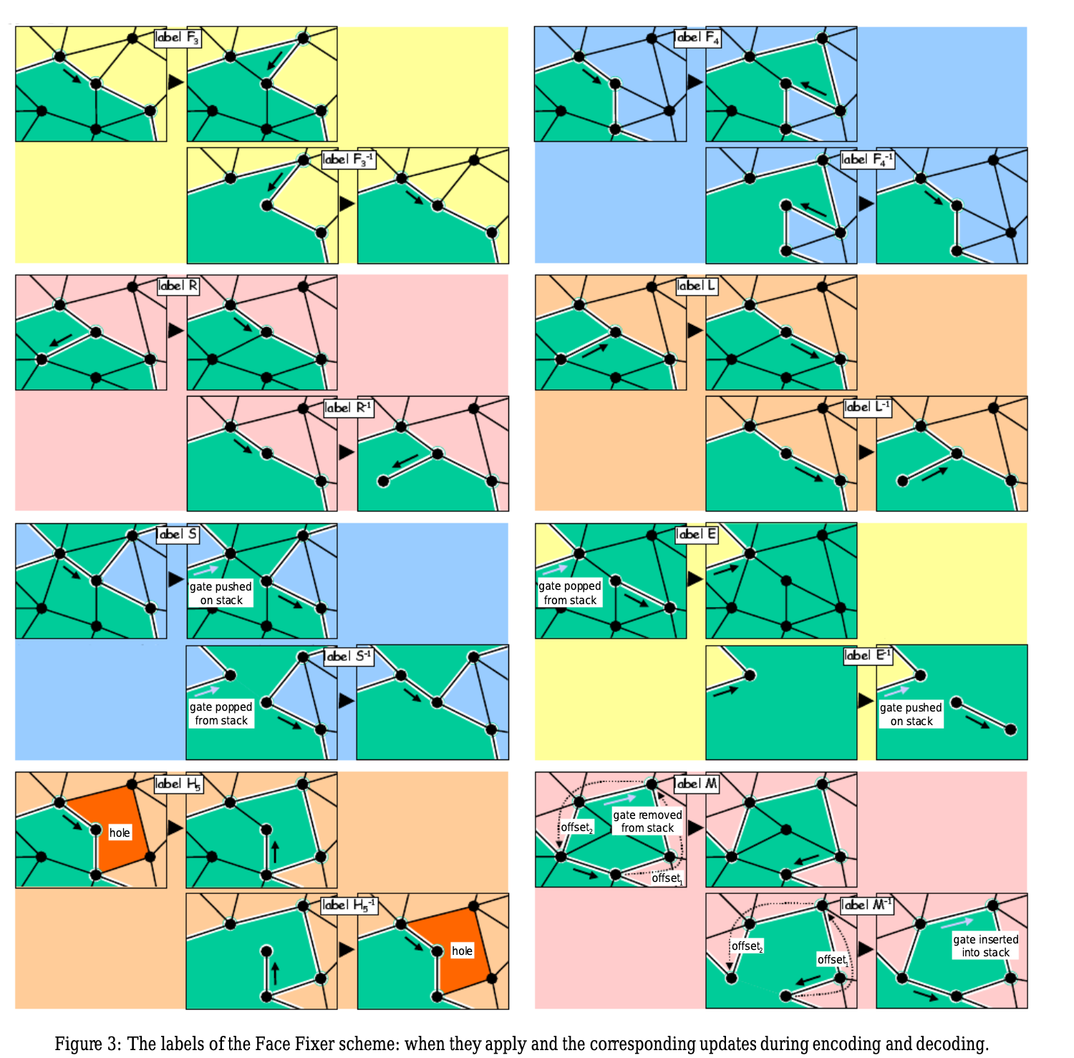
1.1 Connectivity Compression
1.1.3 Some Compressing Polygon Meshes
Degree higher than 3 (not triangles)
Face traversal
1) Face Fixer algorithm compresses the connectivity with arbitrary face degrees using a face traversal of the mesh. The encoder generates one symbol per edge.
The decoding process reconstructs the connectivity of the polygon mesh with a single reverse traversal of the label sequence. Each label has a unique inverse operation.

Slide 14
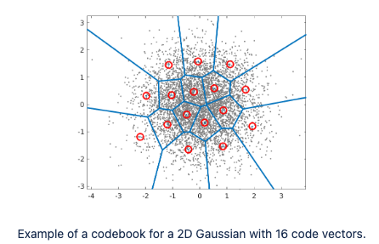
1.2 Geometry Compression
1.2.1 Basic Quantization
Decrease the precision of each point ( IEEE 32-bit )
Scalar quantization
Transforming the ﬂoating-point number positions into integer positions.
Vector quantization
divides the set of points into groups.
quantization cells are no longer cuboids.
Each group has a representative point.

Slide 15
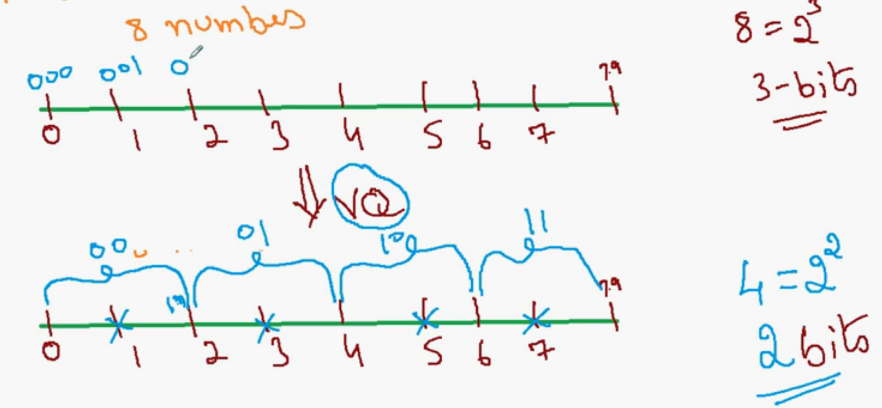
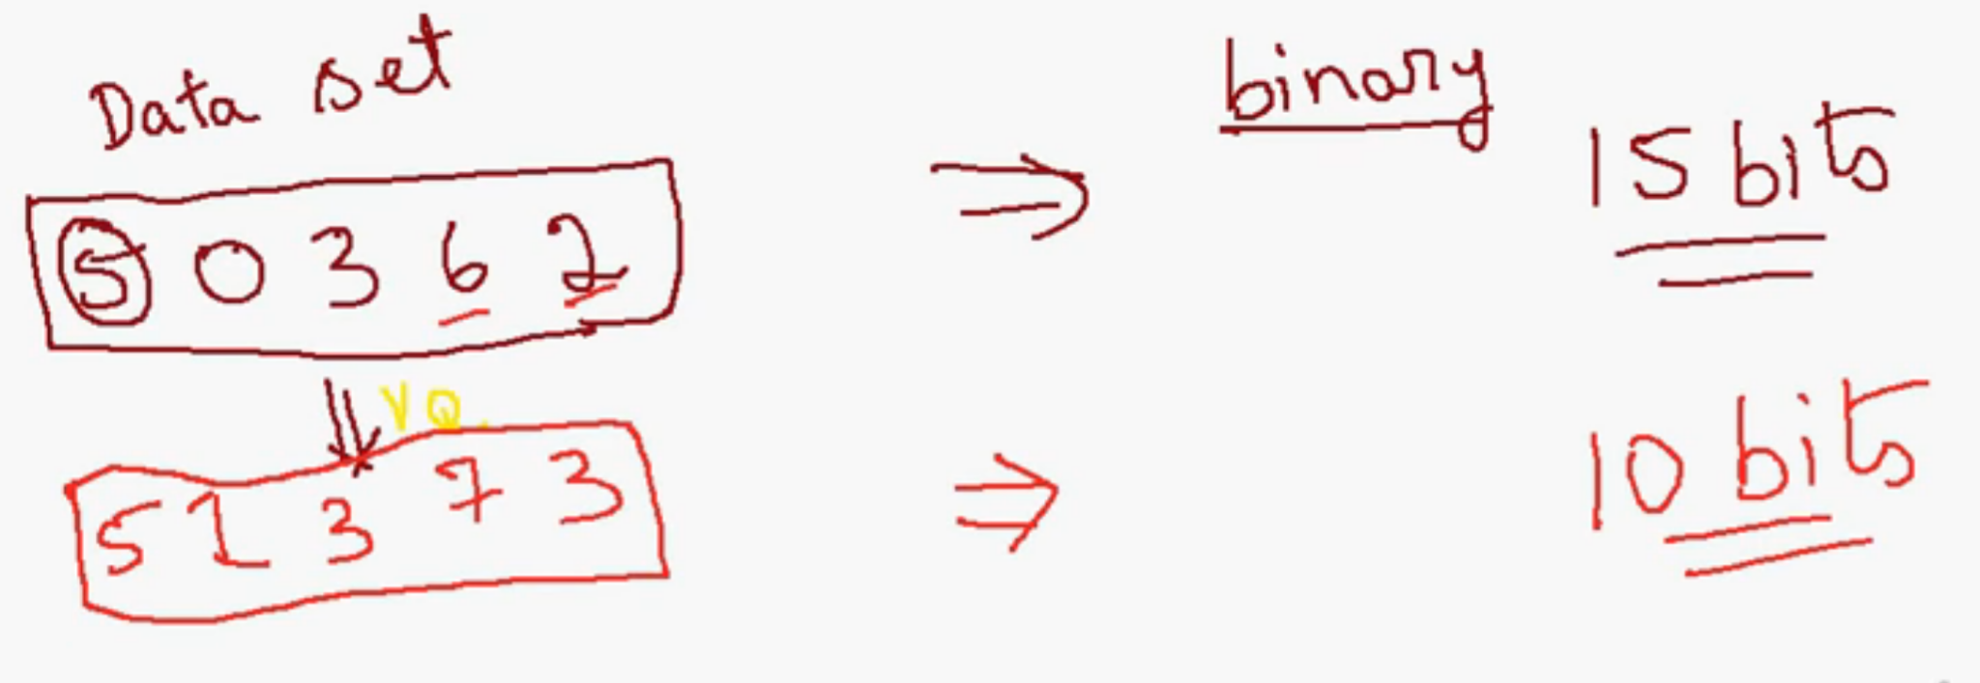
1.2 Geometry Compression
1.2.1 Vector quantization
0 -> 1
1.6 -> 1
3.4 -> 3
con: Lose data after compression

Slide 16
1.2 Geometry Compression
1.2.2 Prediction
Parallelogram prediction
Introduces a new vertex with a triangle.
And form a parallelogram.
Dual parallelogram prediction
Freelence prediction
Multiway prediction
Weighted parallelogram prediction
Parallelogram prediction is a founding idea that has inspired many later schemes.

Slide 17
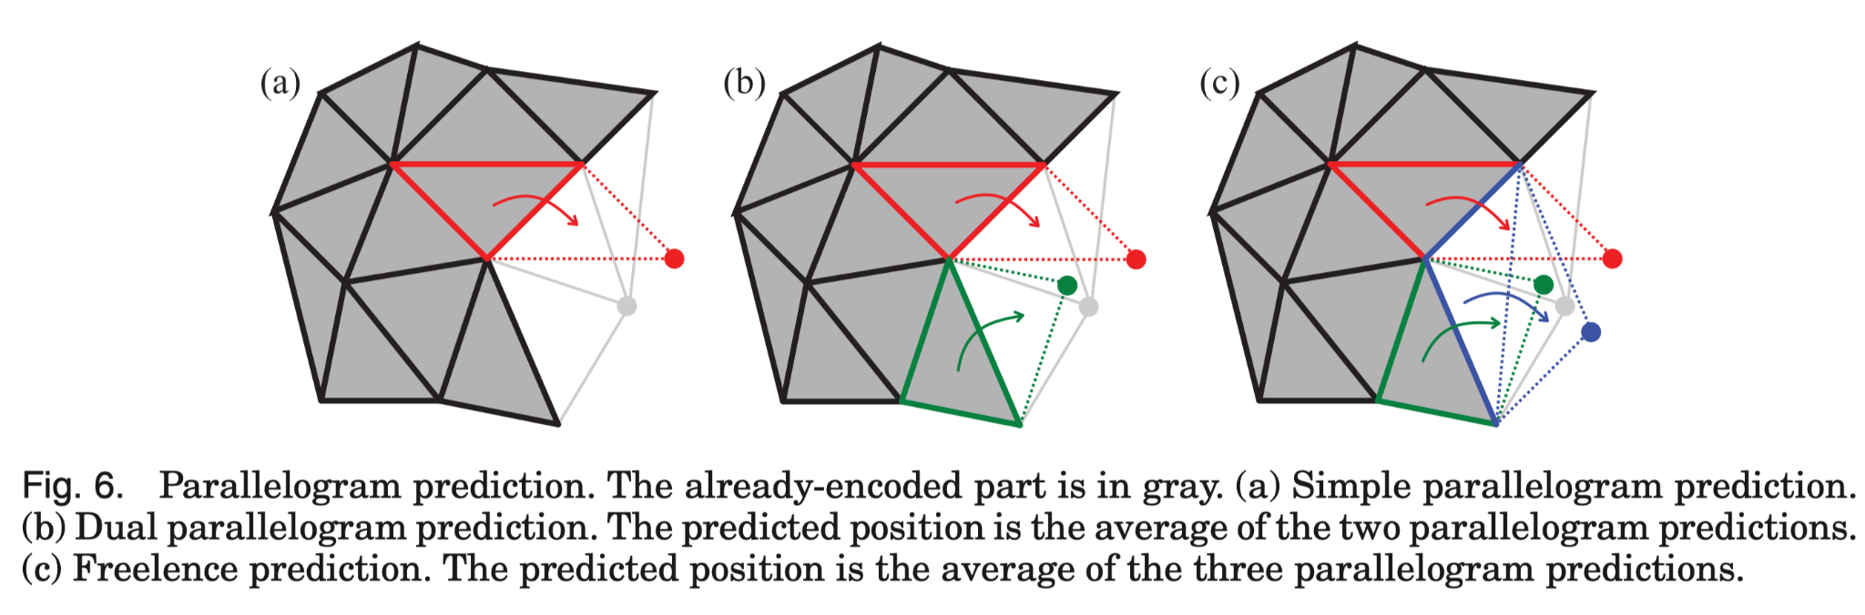
1.2 Geometry Compression
Multiway prediction:
Predict the position of new vertices with as many parallelogram predictions as possible based on already-encoded vertices.
Weighted parallelogram prediction:
Weights are computed in a function of the vertex valences (the number of edges at the vertex)

Slide 18
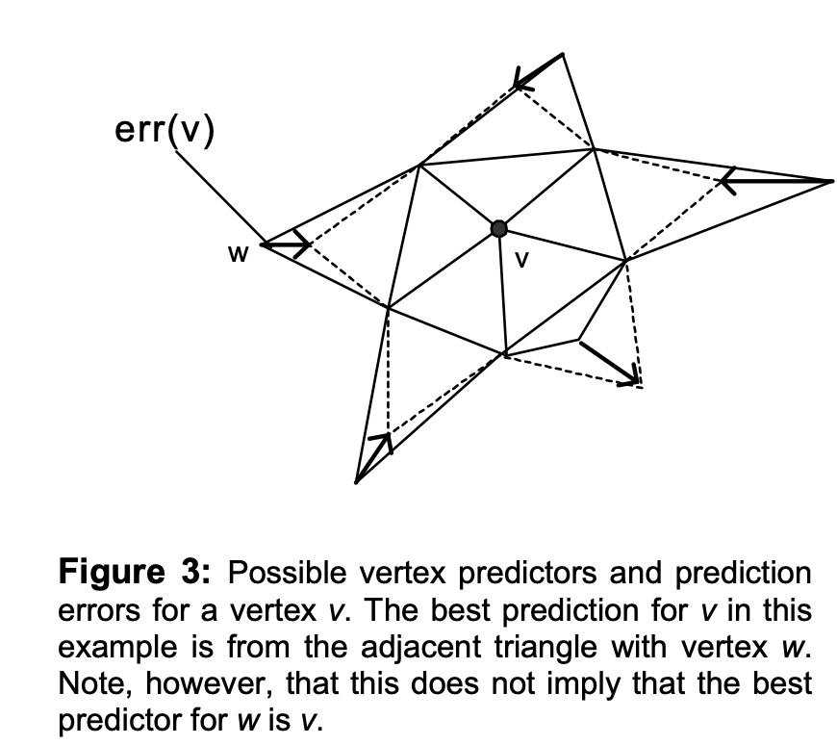
1.2 Geometry Compression
1.2.3 Geometry-Driven Compression
Key: mesh triangle traversal order is important for coding the geometry
Result:
Minimize the parallelogram prediction errors

Slide 19
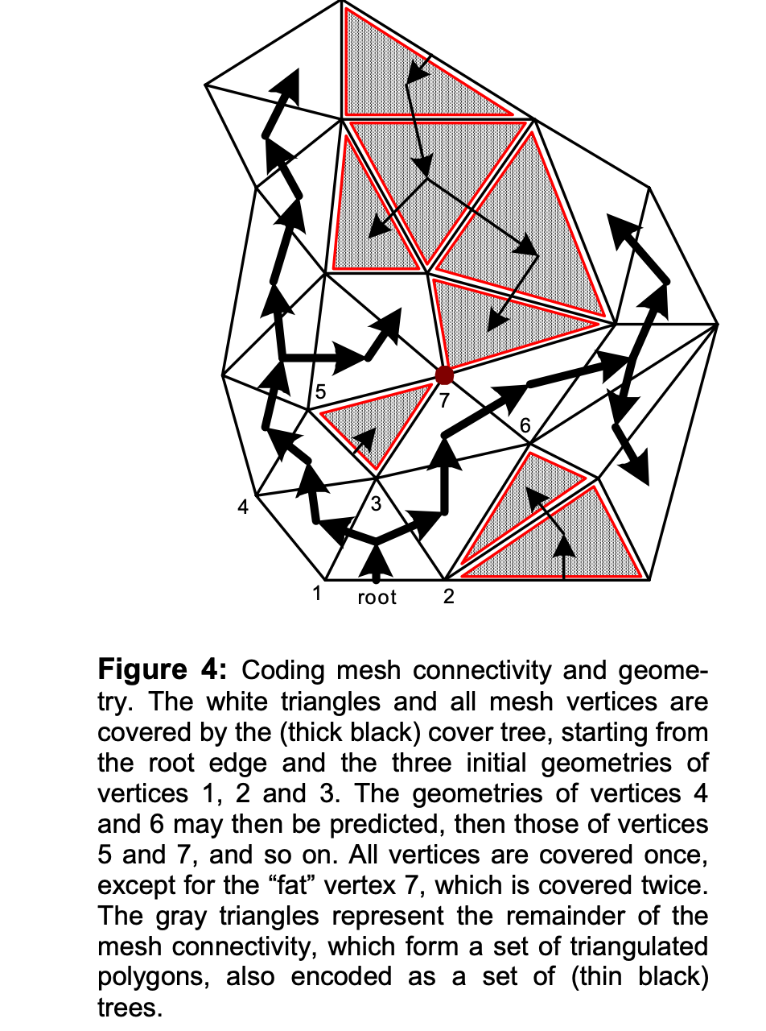
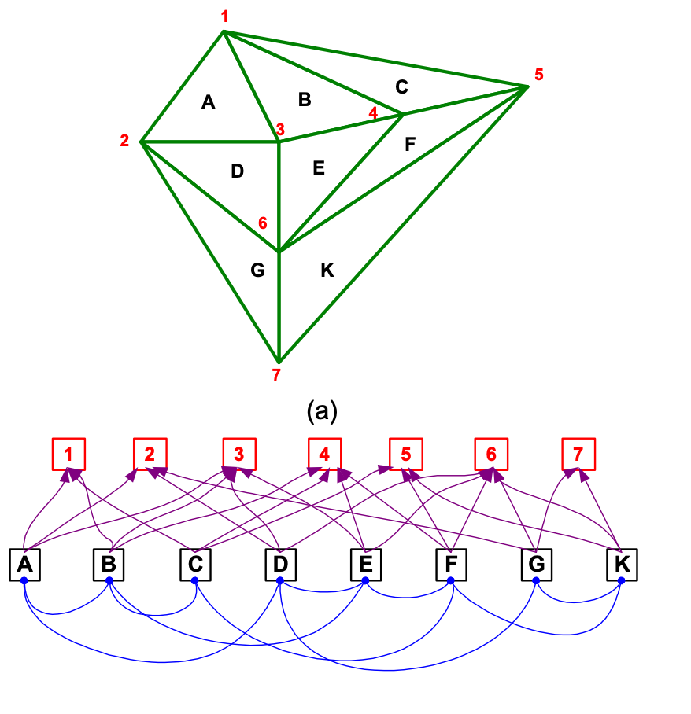
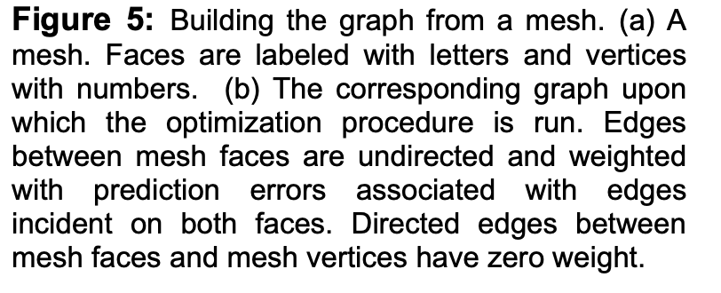
1.2 Geometry Compression
Kronrod and Gotsman [2002]
COVER TREE (vertex stored in order)
Traverses a subset of the triangles in the mesh,
adjacent triangles
vertices are contained at least once
Key: this cover tree is a subset of the mesh triangles.
mesh -> graph -> cover tree
cover tree

Slide 20
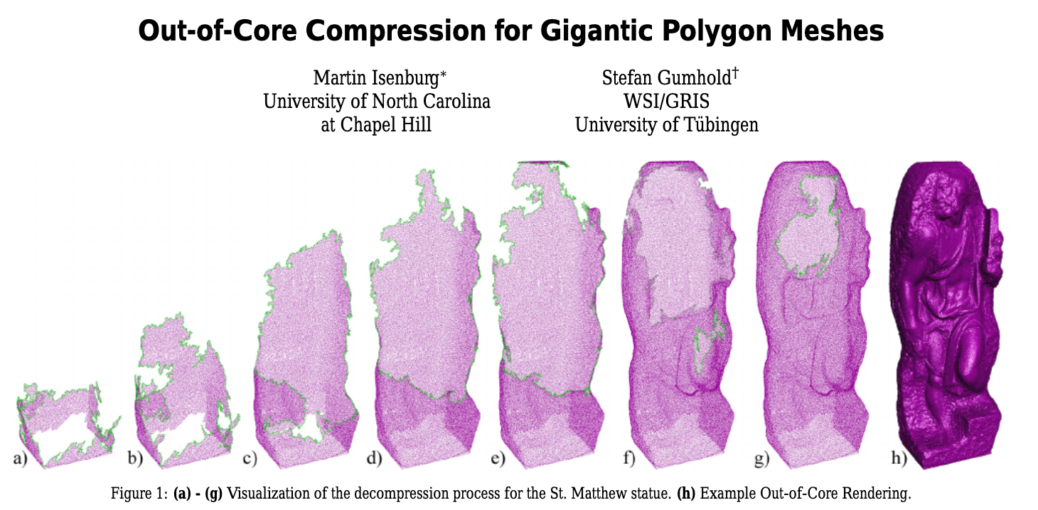
1.3 Handling Large Meshes
Some models are too large to ﬁt into the main memory of computers.
Out-of-core schemes were designed to compress such models.
Dynamically load and unload the different parts of the mesh depending on the currently processed region of the mesh.
One example:
Partitioning the input model. Each part is compressed independently in-core.
-> The Edgebreaker compression algorithm compresses the connectivity.
-> For the geometry compression, use the parallelogram prediction.

Slide 21
2. Progressive mesh Compression

Slide 22
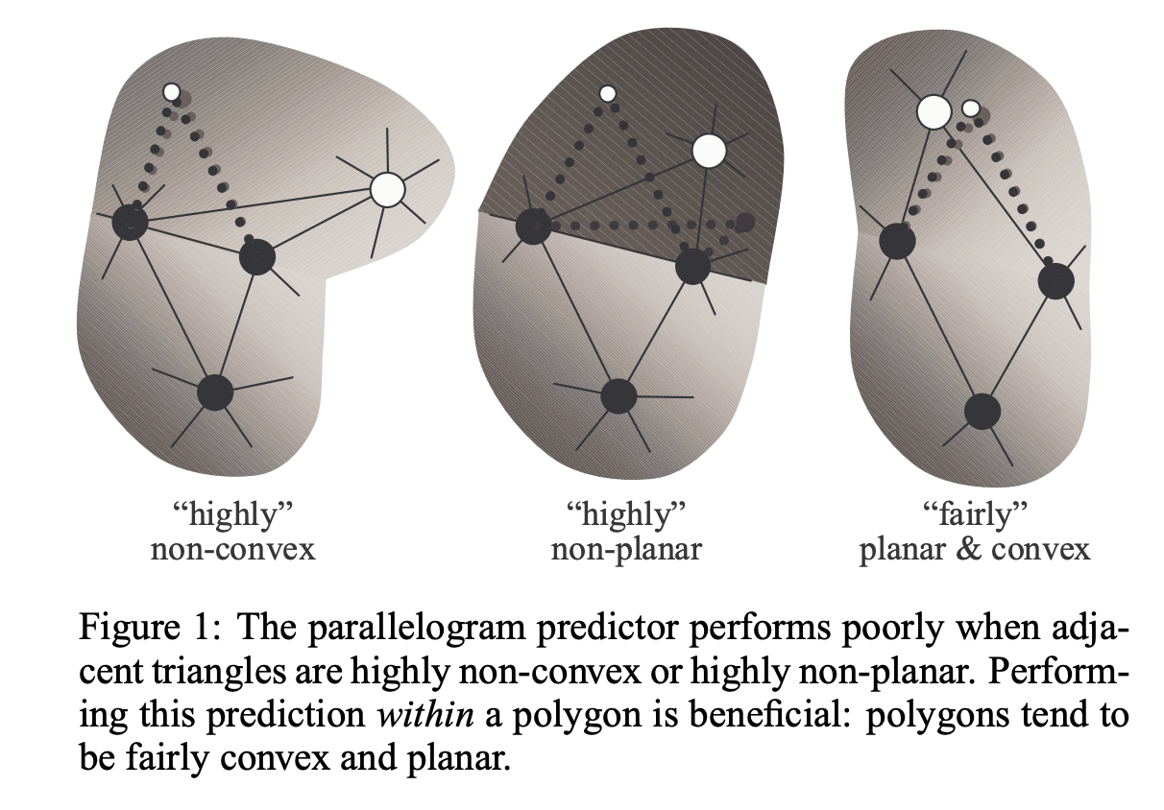
1.2 Geometry Compression

Slide 23
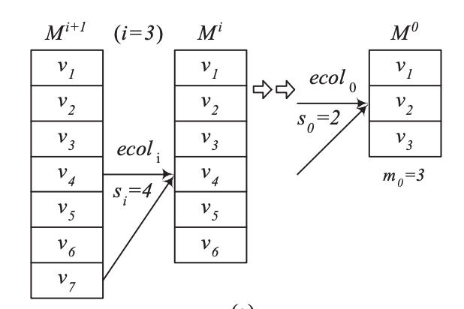
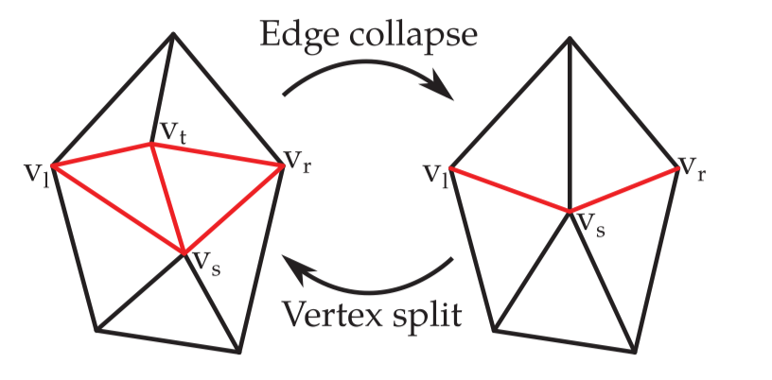
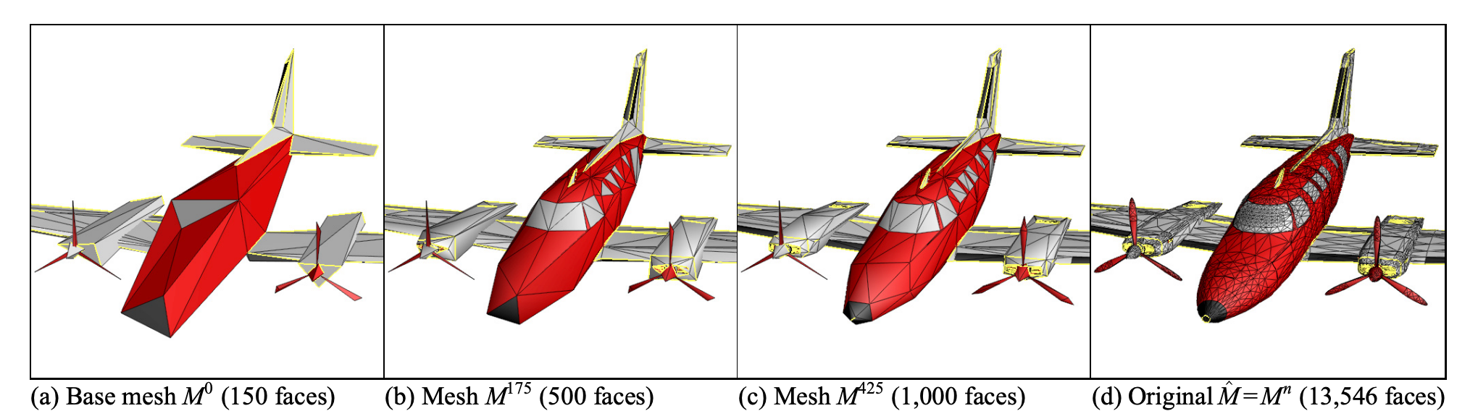
2.1.1 Vertex Split and Edge Collapse.
Vertex Split and Edge Collapse.
A key observation is that an edge collapse transformation is invertible.
As an example, Figure 5 (13546 faces) was simpliﬁed down to the coarse mesh M0 of Figure a (150 faces) using 6,698 edge collapse transformations

Slide 24
2.1.1 Vertex Split and Edge Collapse.
Pajarola and Rossignac [2000]
Performing as many edge collapse as possible to generate of a new level of detail. Vertex splits are then encoded by building a vertex spanning tree on the mesh. The vertex positions are uniformly quantized.
(Recall: Scalar quantization)
Junlin Li, Dihong Tian, and Ghassan AlRegib [2006]
extends the algorithm above by using the vector quantization.
(Recall: Vector quantization)
Karni et al. [2002]
Enables the fast rendering with vertex buffers.
Vertex buffers have been introduced by graphic hardware manufacturers
By reuse vertex data to generate triangle strips

Slide 25
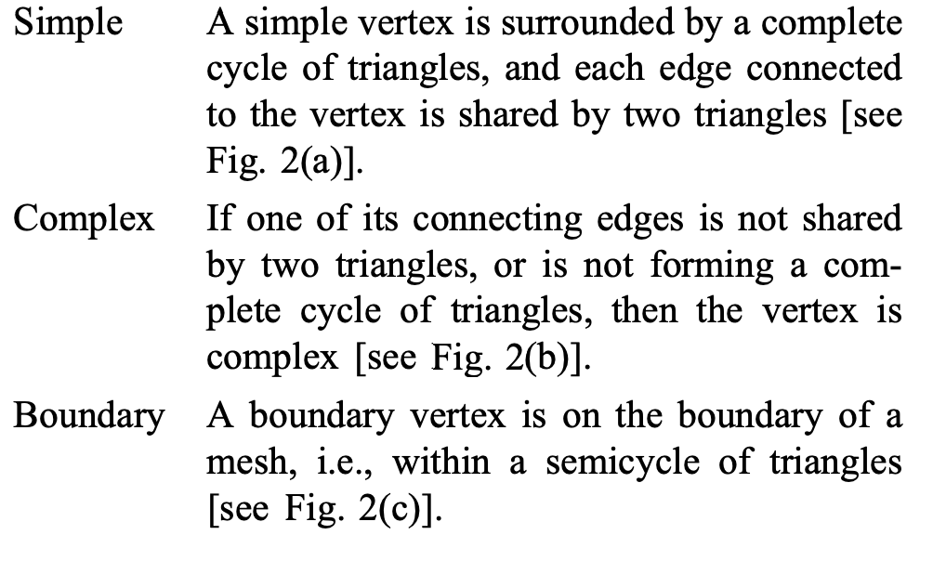
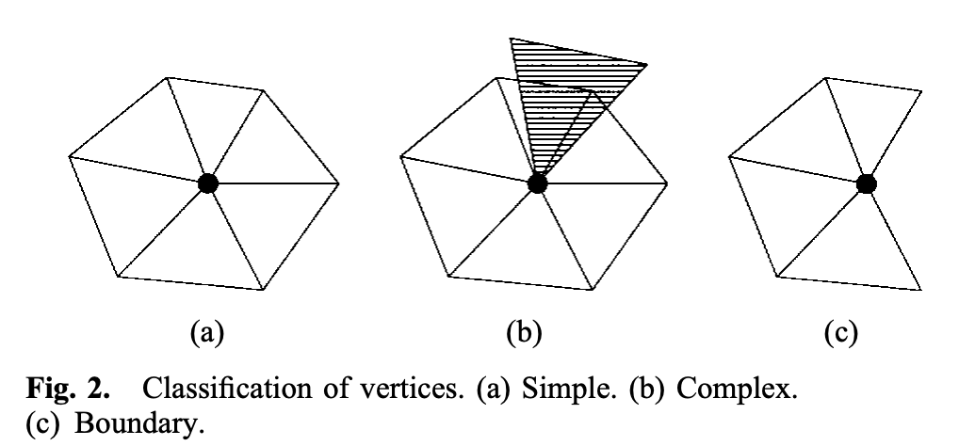
2.1.2 Vertex Removals
Li and Kuo [1998b]
Each vertex are checked for removal (classified into three types).
To preserve the topology, complex vertices are not deleted from the mesh.
Only simple and boundary vertices are candidates for removal.

Slide 26
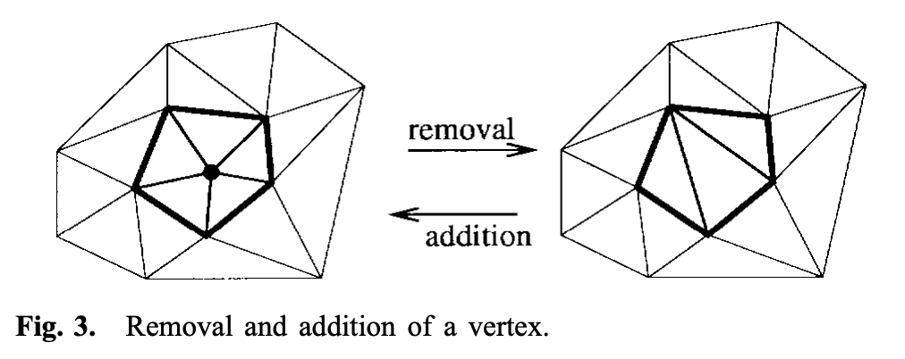
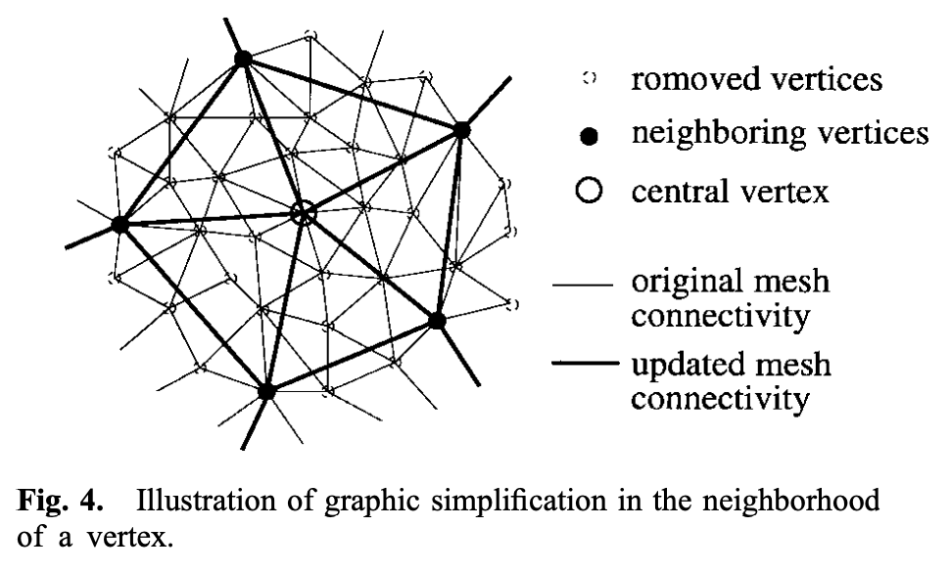
2.1.2 Vertex Removals
Remove a vertex and all triangles depending on that vertex results in a hole in the mesh.
This hole is patched by local retriangulation.

Slide 27
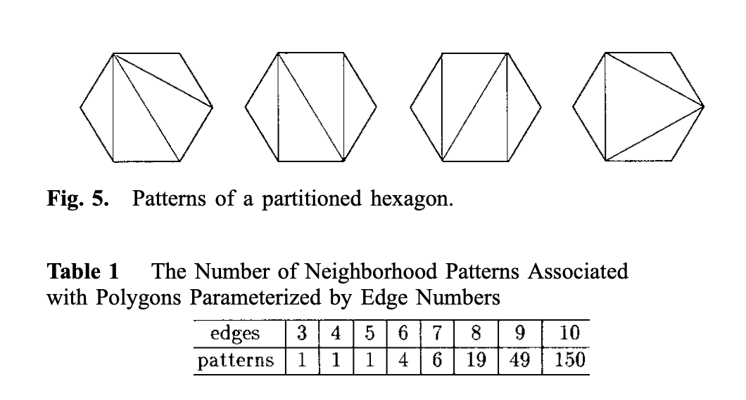
2.1.2 Vertex Removals
The connectivity data is encoded with
local index that speciﬁes the patch pattern
global index that locates this pattern in the whole mesh
The geometry data is encoded with a barycentric error prediction.
Total 231 patterns (less than or equal to ten neighborhoods)
An 8-bit index set can be used to represent these patterns and stored in both the encoder and the decoder.

Slide 28
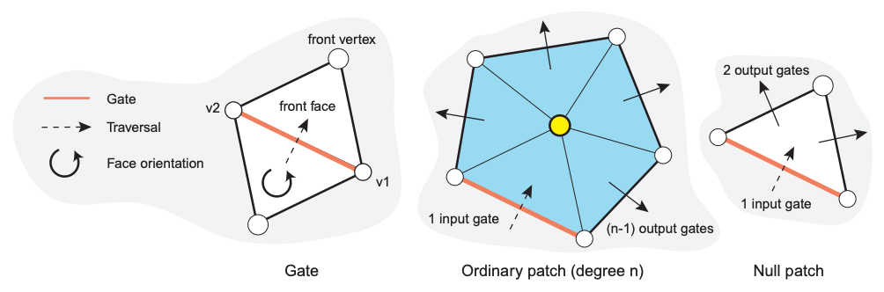
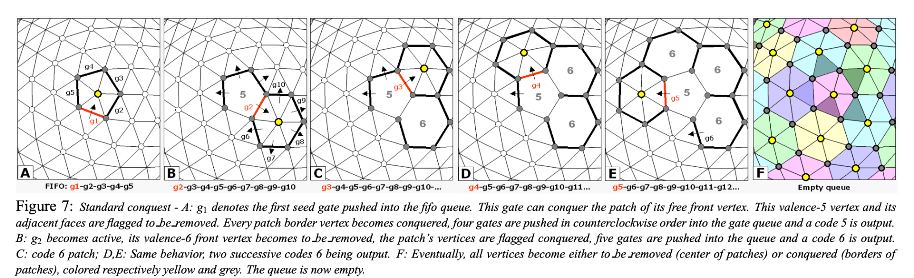
Alliez and Desbrun [2001a]
Conquest (fifo queue)
Case1: if front face is tagged conquered or to_be_removed (skip)
Case2: if front vertex is free and has a valence <= 6 (The front vertex is flagged to_be_removed, its neighboring vertices are flagged conquered)
Case 3: if front vertex is free and has a valence > 6 (mark it conquered, and push two other output gates into the fifo queue)

Slide 29
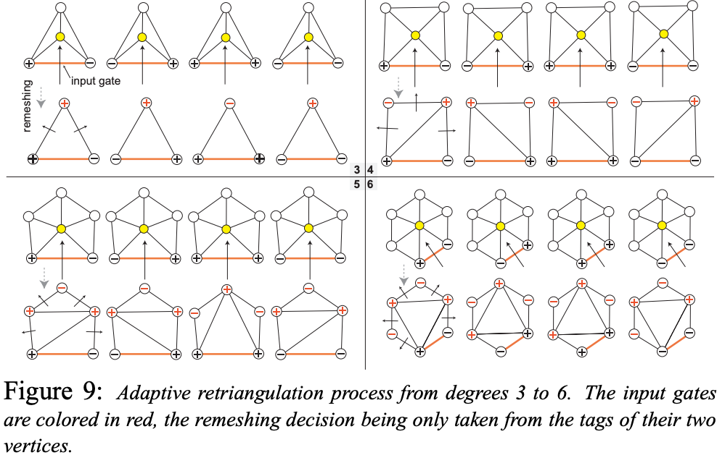
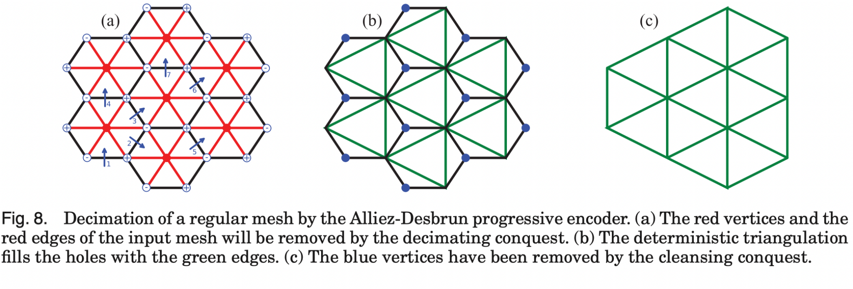
Alliez and Desbrun [2001a]
b. Patch Retriangulation
Vertices are tagged with either ⊕ or ⊖ depending if their valence should be increased or decreased.
(a) The red vertices and the red edges of the input mesh will be removed
(b) The deterministic triangulation ﬁlls the holes with the green edges.
c. Cleaning Conquest
A cleansing conquest (from b to c in Figure 8) removes valence 3 vertices.

Slide 30
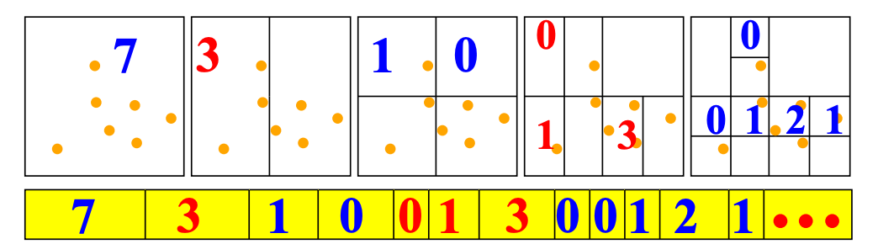
2.1.3 Geometry-Driven Progressive Mesh Compression
Gandoin and Devillers [2002]
The coding sequence consists only of the numbers of points.
The positions of these points are hidden in the order of the output.
The cell size decreases and the more accurate localization it is.
The number of points in the second half-cell does not have to be encoded.
Until there is no non-empty cell greater than 1
The geometry coder on a two-dimensional example.

Slide 31
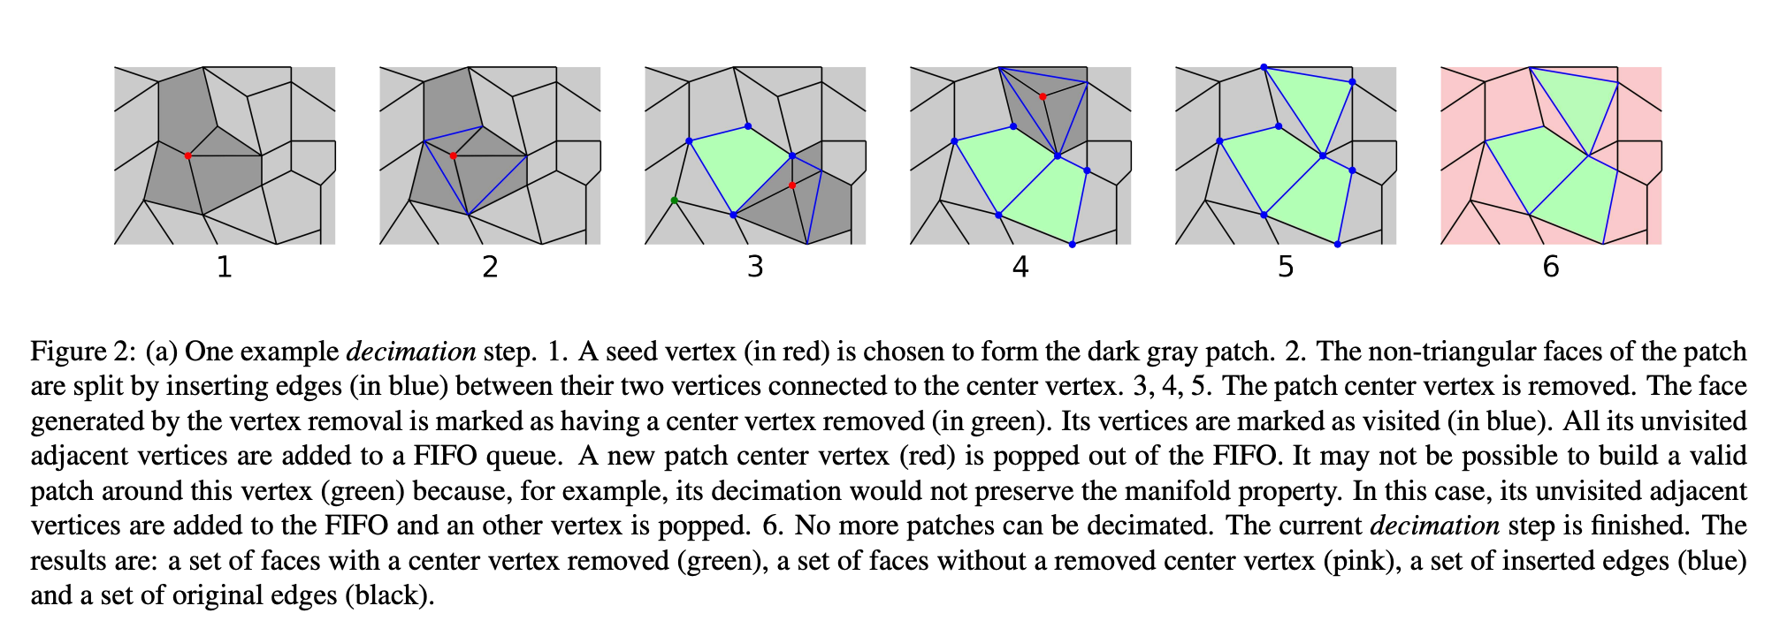
2.1.5 Polygon Meshes
Maglo et al. [2012]
Key: Removes the patch center vertex and remesh locally
The mesh connectivity is encoded by two lists of Boolean symbols:
One for the inserted edges (BLUE edge)
One for the faces with a removed center vertex (GREEN face)
All its unvisited adjacent vertices are added to a FIFO queue.

Slide 32
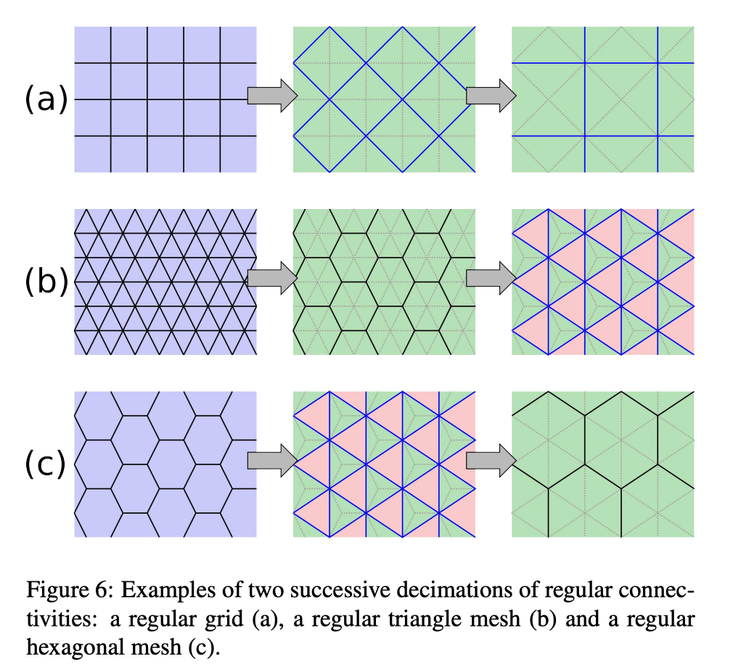
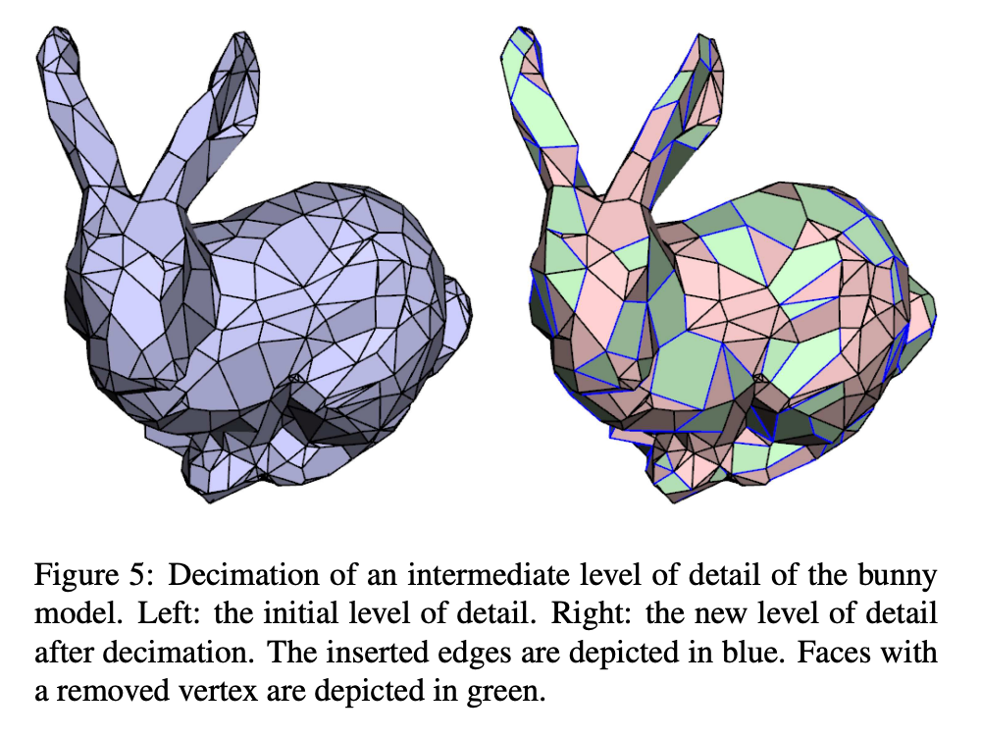
2.1.5 Polygon Meshes

Slide 33
3. Random Accessible Compression

Slide 34
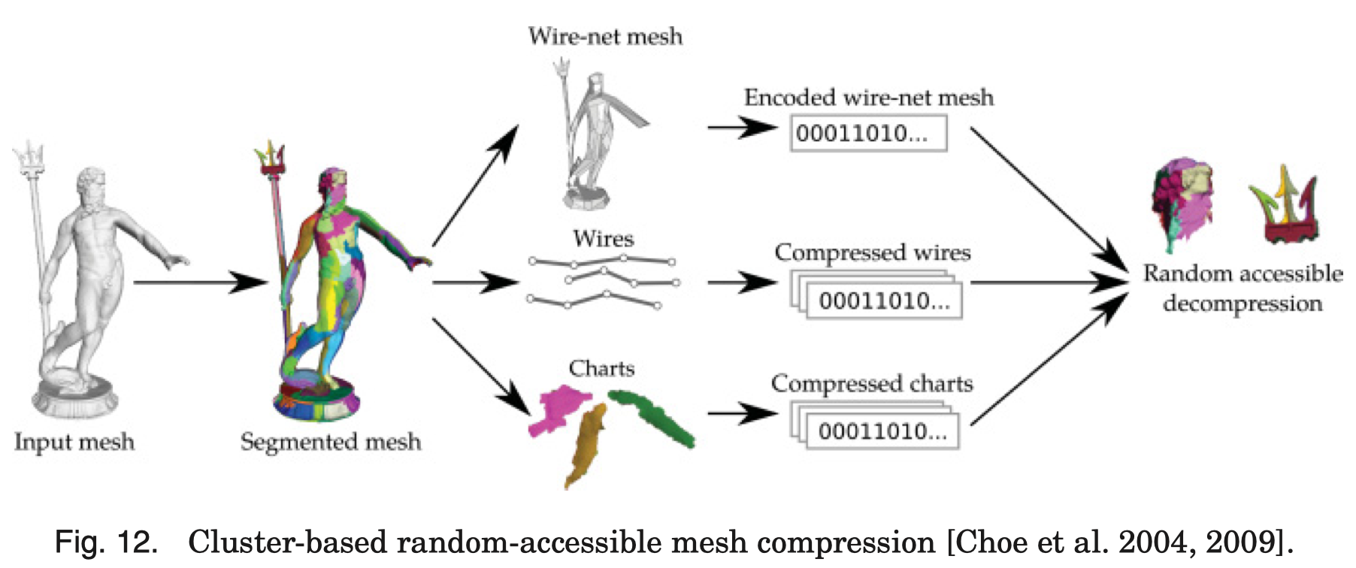
3.1 Random Accessible Compression
3.1.1 Cluster-Based Random Accessible Compression
Chart are desired to be planar.
each chart is independently compressed using the single-rate encoder.
Wire: To avoid duplication of geometry information of the border vertices shared by two charts, their positions are compressed independently in sequences called wires.

Slide 35
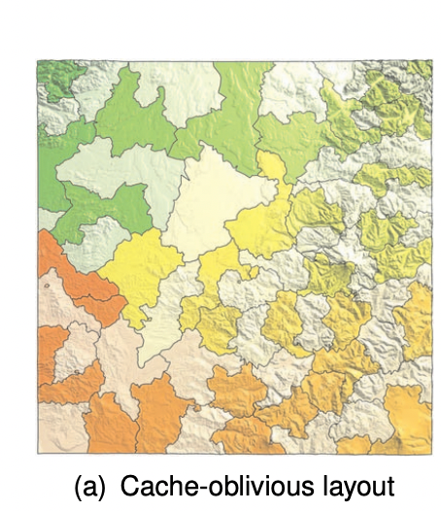
3.1 Random Accessible Compression
3.1.2 Yoon and Lindstrom [2007]
(cluster-based random accessible compression scheme)
Group the mesh triangles and vertices in a cache-oblivious layout.
Each cluster is composed of a constant number of triangles (a few thousand) and are compressed independently
The geometry information of the border vertices is not duplicated: it is encoded one time in a cluster and referenced for the others.

Slide 36
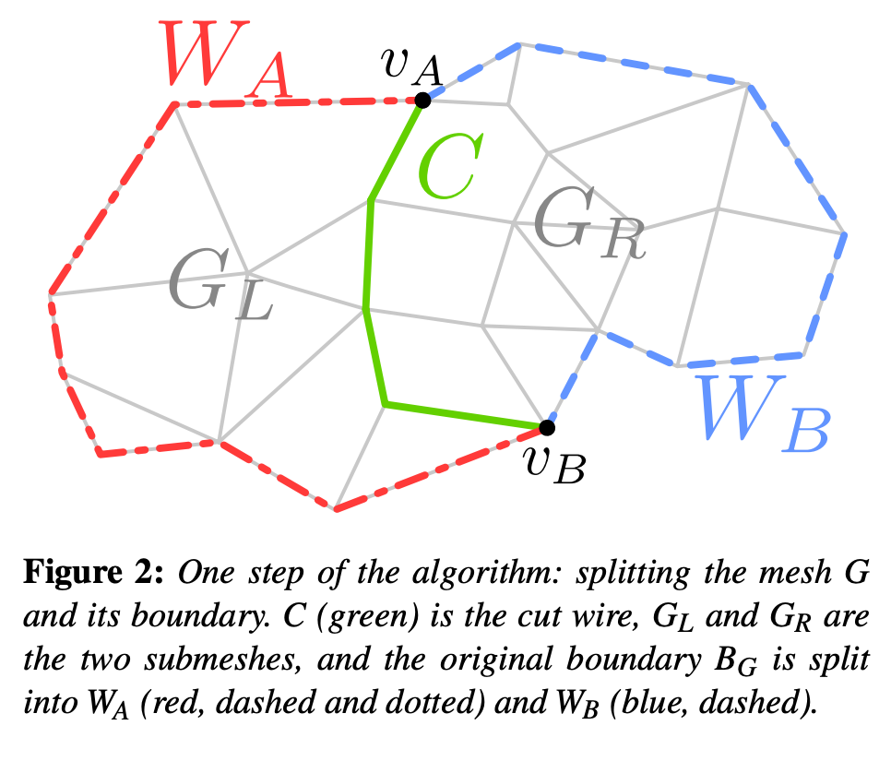
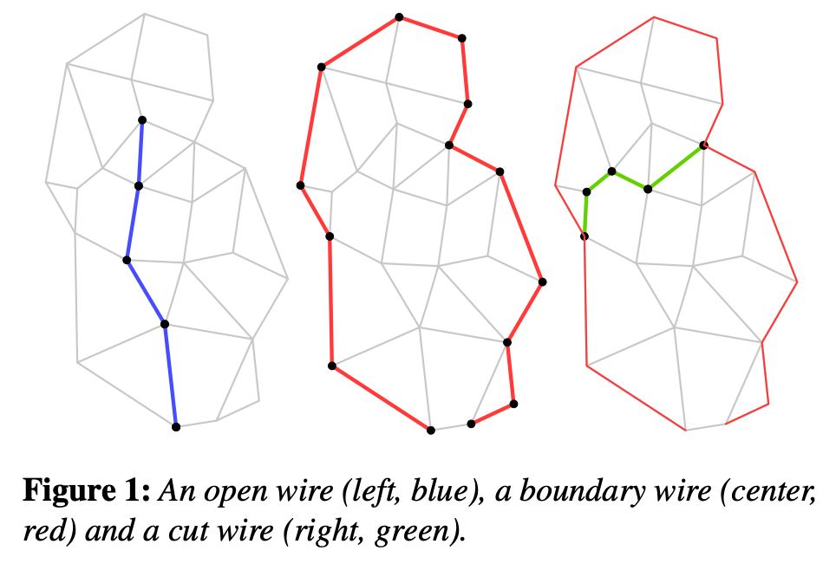
3.1 Random Accessible Compression
3.1.3 Hierarchical Random Accessible Compression
The input mesh, which contains an already-encoded exterior boundary, is split into two balanced partitions.
Both partitions are then recursively split in the same way until each partition contains only one polygon.

Slide 37
3.2 Progressive and Random Accessible Compression
3.2.1 Connectivity-Based Algorithms
Cheng et al. [2007]
progressive random accessible mesh compression algorithm
Cutting the mesh into parts along concave
Each part encoded with a modiﬁed version of the progressive encoder from Alliez and Desbrun [2001a] [page32]
3.2.2 Geometry-Based Algorithms
Jamin et al. [2009] and Du et al. [2009]
Adding random access support to the original Gandoin and Devilliers [2002] [page34]
progressive algorithm.
During the decompression, different levels of detail can be selected for the different cells.

Slide 38
Class Project
Point clouds Compression

Slide 39
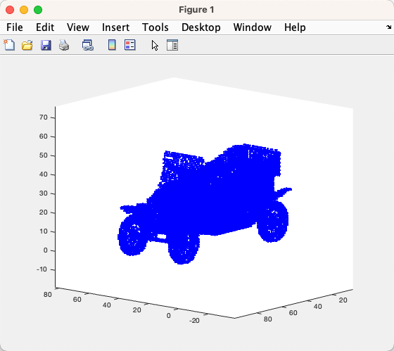
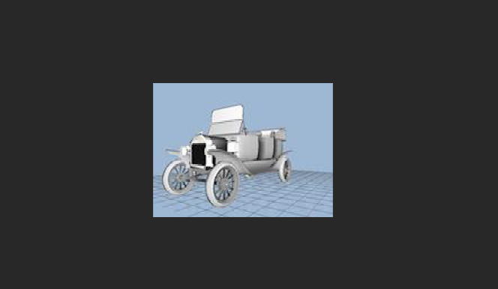
1 Why?
Figure 1: Princeton Shape Benchmark
Figure 2: https://github.com/shahramg/FLS-Multimedia2022

Slide 40
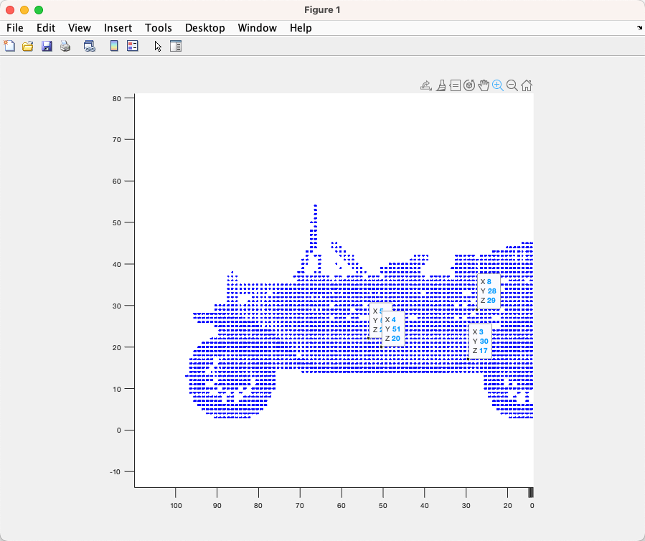
Tools: Matlab, Github
Figure 3: https://github.com/shahramg/FLS-Multimedia2022

Slide 41
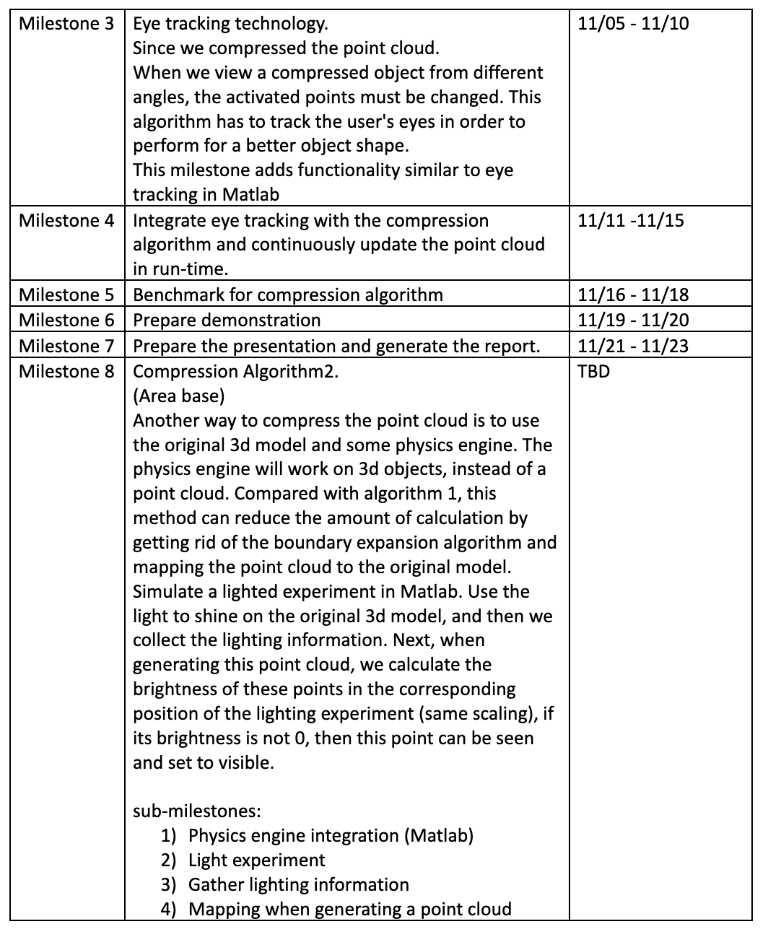
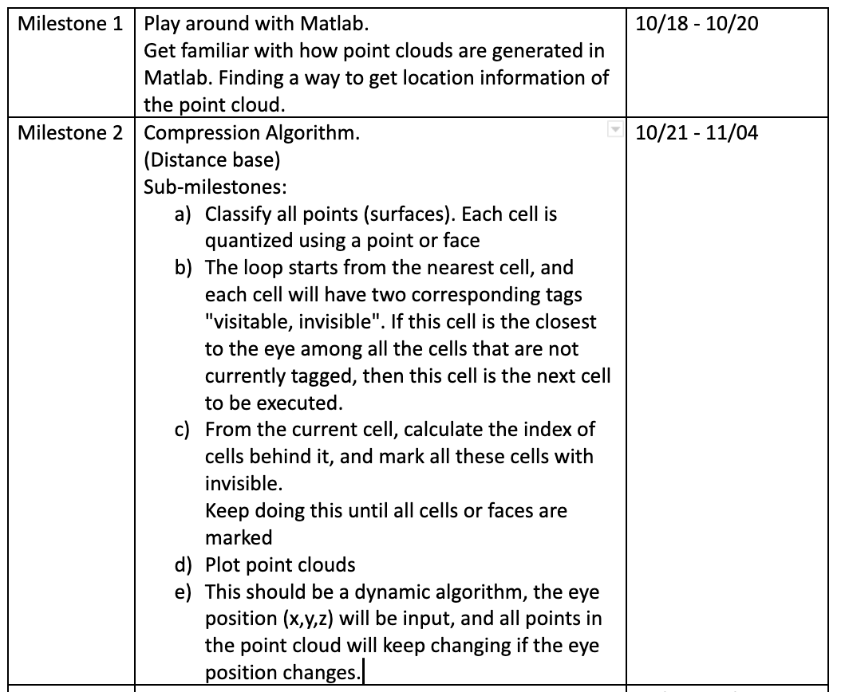

Slide 42
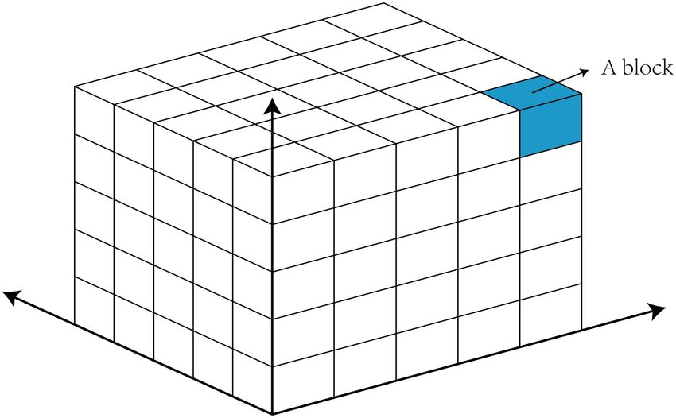
Algorithm:
Divide a 3d space into small cells(block)
ex:
1000*1000*1000 (x,y,z)
-> 1000000000 cells
-> Each cell is 1*1*1
Distinguish which cells have points. These cells will be grouped into display cells {unvisited}
Use vector quantization

Slide 43
Algorithm:
Label cells with {visible, invisible,unvisited }
Pick the nearest unvisited cell. This cell must be visitable.
…
…
Add eye tracking
Run time update
.
.
.
.

Slide 44
Thank you

